Slide 1
Object Oriented Programming (OOP)
Week – 01
Dated: dd/mm/yyyy
Instructor: AHMED AWAIS

Slide 2
Course Outline
Let’s discuss it !

Slide 3
Books
For JAVA:
"Java How to program", 8th or higher Edition, Deitle & Detile, ISBN-978-81-203-3832-6, PHI learning Pvt.Ltd.
Beginning Java 2 by Ivor Horton, Wrox Beginning Guides.
Java, The complete reference. Oracle publication.
For C++:
“Problem Solving with C++”, 9th edition, Walter Savitch
“C++ How to Program” , 7th edition, Deitel & Deitel
C++ the complete reference, 4th edition - herbert schildt

Slide 4
Programming Paradigms
1- Sequential
2- Procedural
3- Object Oriented

Slide 5
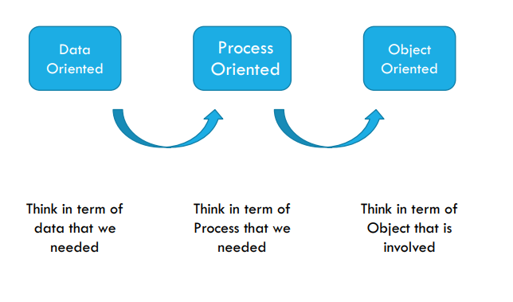
Programming Paradigms
Notes:
Think like everything (object) has State, Behavior (function),

Slide 6
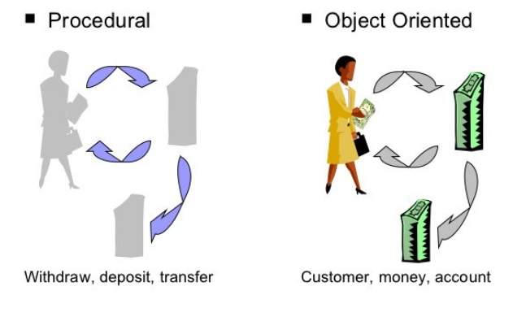
Procedural vs. Object-Oriented Programming
Notes:
In OOP, anything that has state and behavior can be represented as an object. Even though a desk may not have active behavior like a car or a person, it still has a state (attributes) and can have simple behaviors (functions that define what you can do with the desk).

Slide 7
Procedural vs. Object-Oriented Programming
The unit in procedural programming is function, and unit in object-oriented programming is class
Procedural programming concentrates on creating functions, while object-oriented programming starts from isolating the classes, and then look for the methods inside them.

Slide 8
Think of everything in the world as an object. Each object has two key characteristics:
In OOP, we model real-world objects in our programs by defining classes (blueprints for objects) and their state (attributes) and behavior (methods).” Example: Car (Object): State (Attributes): Color: Red Speed: 60 km/h Behavior (Methods): Start Accelerate Brake
State: This represents the data or attributes of the object (what it is). Example: A car has attributes like color, speed, and model. Behavior: This represents the actions or functions that the object can perform (what it can do). Example: A car can perform actions like starting, accelerating, and stopping.

Slide 9
What is a Model?
A model is an abstraction of something
Real World Entities
Purpose is to understand the product before developing it

Slide 10
Examples – Model
Highway maps
Architectural models
Mechanical models

Slide 11
Example – OO Model

Slide 12
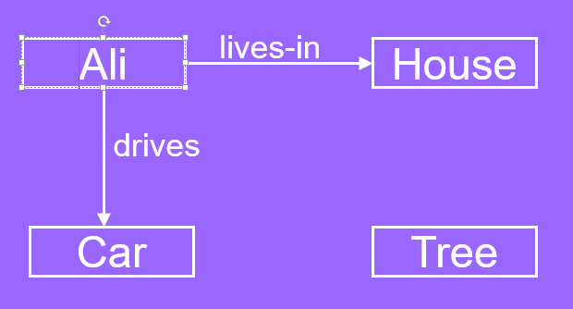
…Example – OO Model
Objects
Ali
House
Car
Tree
Interactions
Ali lives in the house
Ali drives the car

Slide 13
Object-Orientation - Advantages
People think in terms of objects
OO models map to reality
Therefore, OO models are
easy to develop
easy to understand

Slide 14
Class and Object
A class is a data type that allows programmers to create objects. A class provides a definition for an object, describing an object’s attributes (data) and methods (operations).
An object is an instance of a class. With one class, you can have as many objects as required

Slide 15
Structure V/S Class

Slide 16
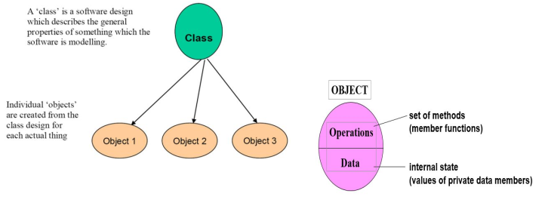
Class and Object

Slide 17
What is an Object?
An object is
Something tangible (Ali, Car)
Something that can be apprehended intellectually (Time, Date)
An object has
State (attributes)
Well-defined behaviour (operations)
Unique identity

Slide 18
Concept: An object has behaviors
An object contains both data and methods that manipulate that data
An object is active, not passive; it does things
An object is responsible for its own data
But: it can expose that data to other objects

Slide 19
Example – Ali is a Tangible Object
State (attributes)
Name
Age
Behavior (operations)
Walks
Eats
Identity
His name

Slide 20
Example – Car is a Tangible Object
State (attributes)
- Color
- Model
Behavior (operations)
- Accelerate - Start Car
- Change Gear
Identity
- Its registration number

Slide 21
Data Abstraction
Abstraction means displaying only essential information and hiding the details.
Data abstraction refers to providing only essential information about the data to the outside world, hiding the background details or implementation.

Slide 22

Data Abstraction (Example)

Slide 23
Advantages of Information Hiding
Simplifies the model by hiding implementation details
Prevents accidental access
Prevents illegal access or manipulation

Slide 24
Concept: Classes form a hierarchy
Classes are arranged in a treelike structure called a hierarchy
The class at the root is named Object
Every class, except Object, has a superclass
A class may have several ancestors, up to Object
When you define a class, you specify its superclass
If you don’t specify a superclass, Object is assumed
Every class may have one or more subclasses

Slide 25
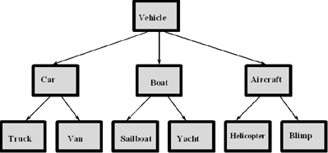
Example of (part of) a hierarchy
A class hierarchy for a vehicle rental company.

Slide 26
Exercise!
Scenario: A particular talent competition has 5 judges, each of whom awards a score between 0 to 10 to each performer. A performer’s final score is determined by dropping the lowest score received, then averaging the remaining 4 scores.
Task 1: Identify Attributes and functions.
Task 2: Procedural Programming approach?
Task 3: Object Oriented approach? (Model the problem: Identify class, objects)

